Slide 1
INTRODUCTION TO COMPUTING
Course Code: CCINCOM/L
Model Free Prediction: Temporal-Difference Learning
Elizer Ponio Jr.
Faculty Member
Department of Computer Science
College of Computing and Information Technologies (CCIT)
National University
Joseph Marvin R. Imperial
REINFORCEMENT LEARNING
NU College of Computing and Information Technologies
Course Code: CCRNFLRL

Slide 2
Temporal Difference (TD) Learning
INTRODUCTION TO COMPUTING
Course Code: CCINCOM/L
Temporal Difference learning is a combination of Monte Carlo ideas and Dynamic programming ideas.
TD is model-free: no knowledge of MDP transitions/rewards
TD learns from incomplete episodes, by bootstrapping
TD updates a guess towards a guess.
Joseph Marvin R. Imperial
REINFORCEMENT LEARNING
NU College of Computing and Information Technologies
Course Code: CCRNFLRL

Slide 3
TD(0)
INTRODUCTION TO COMPUTING
Course Code: CCINCOM/L
TD(0) is the simplest form of TD learning.
In this form of TD learning, after every step value function is updated with the value of the next state and along the way reward obtained.
Joseph Marvin R. Imperial
REINFORCEMENT LEARNING
NU College of Computing and Information Technologies
Course Code: CCRNFLRL

Slide 4
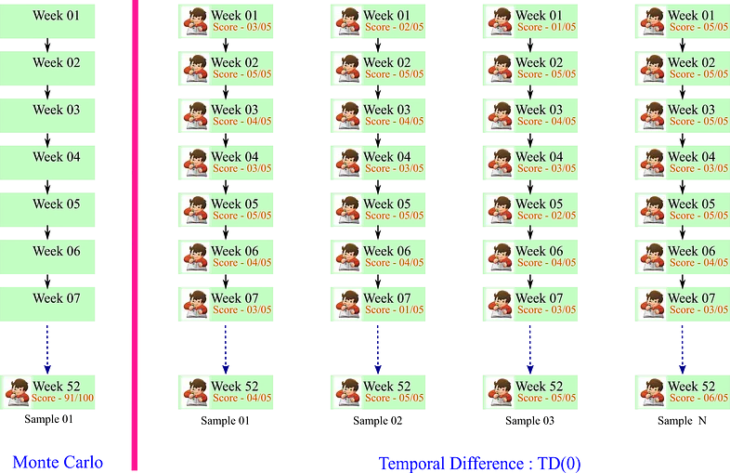
Temporal Difference (TD) Learning
INTRODUCTION TO COMPUTING
Course Code: CCINCOM/L
Joseph Marvin R. Imperial
REINFORCEMENT LEARNING
NU College of Computing and Information Technologies
Course Code: CCRNFLRL

Slide 5


Temporal Difference (TD) Learning
INTRODUCTION TO COMPUTING
Course Code: CCINCOM/L
Goal: Learn $V_{\text{π}}$ online from experience under policy π
Monte-Carlo: Update value V ($S_{\text{t}}$) toward actual return $G_{\text{t}}$
TD : Update value V ($S_{\text{t}}$) toward actual return $estimated return$
Joseph Marvin R. Imperial
REINFORCEMENT LEARNING
NU College of Computing and Information Technologies
Course Code: CCRNFLRL

Slide 6

Temporal Difference
INTRODUCTION TO COMPUTING
Course Code: CCINCOM/L
TD target
TD Error
Joseph Marvin R. Imperial
REINFORCEMENT LEARNING
NU College of Computing and Information Technologies
Course Code: CCRNFLRL

Slide 7
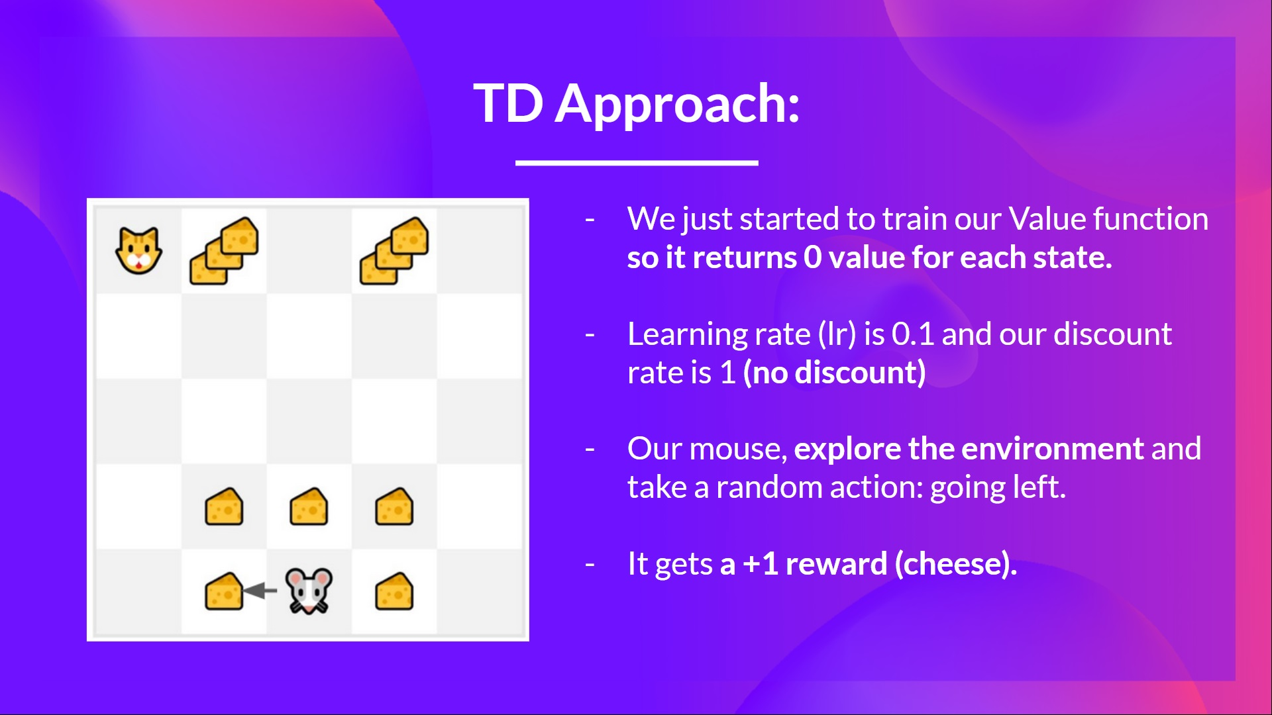
Temporal Difference Approach
INTRODUCTION TO COMPUTING
Course Code: CCINCOM/L
Joseph Marvin R. Imperial
REINFORCEMENT LEARNING
NU College of Computing and Information Technologies
Course Code: CCRNFLRL

Slide 8
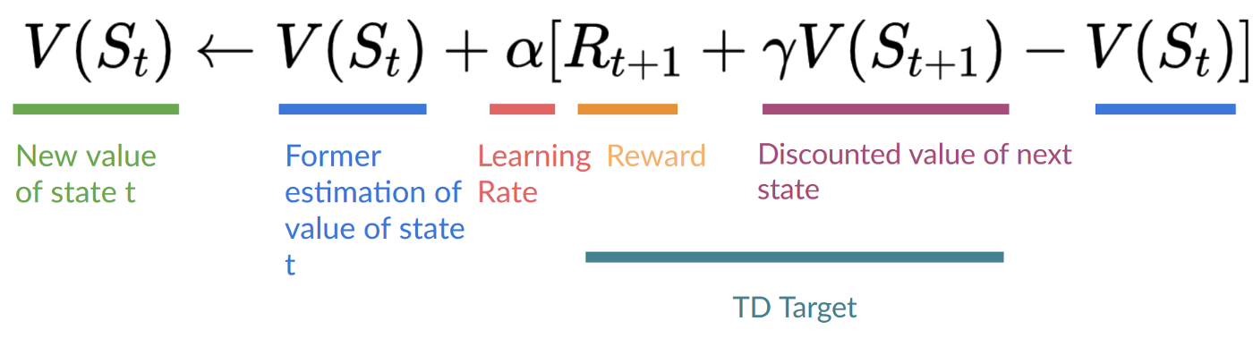
Temporal Difference Approach
INTRODUCTION TO COMPUTING
Course Code: CCINCOM/L
Joseph Marvin R. Imperial
REINFORCEMENT LEARNING
NU College of Computing and Information Technologies
Course Code: CCRNFLRL

Slide 9
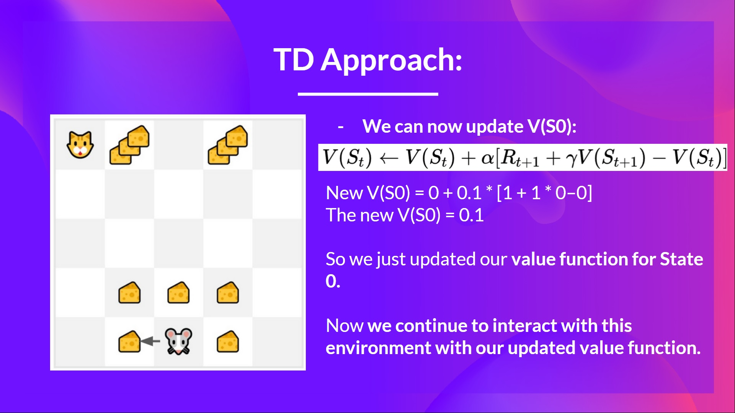
Temporal Difference Approach
INTRODUCTION TO COMPUTING
Course Code: CCINCOM/L
Joseph Marvin R. Imperial
REINFORCEMENT LEARNING
NU College of Computing and Information Technologies
Course Code: CCRNFLRL

Slide 10
Going Home from School Example
INTRODUCTION TO COMPUTING
Course Code: CCINCOM/L
State | Elapsed Time (minutes) | Predicted Time to Go | Predicted Total Time
leaving school | 0 | 30 | 30
walk to train station | 5 | 35 | 40
board train | 20 | 15 | 35
leave train | 30 | 10 | 40
ride jeep | 40 | 3 | 43
arrive home | 43 | 0 | 43
Joseph Marvin R. Imperial
REINFORCEMENT LEARNING
NU College of Computing and Information Technologies
Course Code: CCRNFLRL

Slide 11
Going Home from School Example
INTRODUCTION TO COMPUTING
Course Code: CCINCOM/L
Monte-Carlo
Temporal Difference
Actual Outcome
Predicted total travel time
Predicted total travel time
Situation
Situation
Joseph Marvin R. Imperial
REINFORCEMENT LEARNING
NU College of Computing and Information Technologies
Course Code: CCRNFLRL

Slide 12
Advantages vs Disadvantages of MC vs TD
INTRODUCTION TO COMPUTING
Course Code: CCINCOM/L
TD can learn before knowing the final outcome
TD can learn online after every step
MC must wait until end of episode before return is known
TD can learn without the final outcome
TD can learn from incomplete sequences
MC can only learn from complete sequences
TD works in continuing (non-terminating) environments
MC only works for episodic (terminating) environments
Joseph Marvin R. Imperial
REINFORCEMENT LEARNING
NU College of Computing and Information Technologies
Course Code: CCRNFLRL

Slide 13
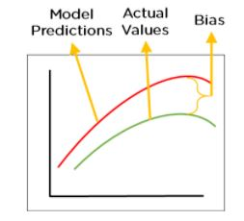
Bias/Variance Trade-off
INTRODUCTION TO COMPUTING
Course Code: CCINCOM/L
Recall that bias and variance are prediction errors.
Recall that bias is the difference between the predicted value and the expected value
A low bias model will make fewer assumptions.
A model with a high bias makes more assumptions.
Joseph Marvin R. Imperial
REINFORCEMENT LEARNING
NU College of Computing and Information Technologies
Course Code: CCRNFLRL

Slide 14
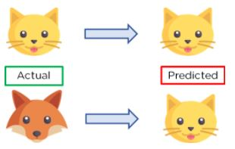
Bias/Variance Trade-off
INTRODUCTION TO COMPUTING
Course Code: CCINCOM/L
Recall that variance specify the amount of variation in the prediction if the different training data was used.
Low variance means there is a small variation in the prediction of the target function with changes in the training data set.
High variance shows a large variation in the prediction of the target function with changes in the training dataset.
Joseph Marvin R. Imperial
REINFORCEMENT LEARNING
NU College of Computing and Information Technologies
Course Code: CCRNFLRL

Slide 15
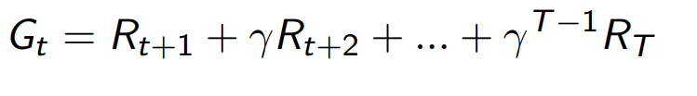
Bias/Variance Trade-off
INTRODUCTION TO COMPUTING
Course Code: CCINCOM/L
The return $G_{t}$ is an unbiased estimate of $V_{\text{π}}$ ($S_{t}$)
Noise on each step
The TD target is a biased estimate of $V_{\text{π}}$ ($S_{t}$)
Noise on first step step
Joseph Marvin R. Imperial
REINFORCEMENT LEARNING
NU College of Computing and Information Technologies
Course Code: CCRNFLRL

Slide 16
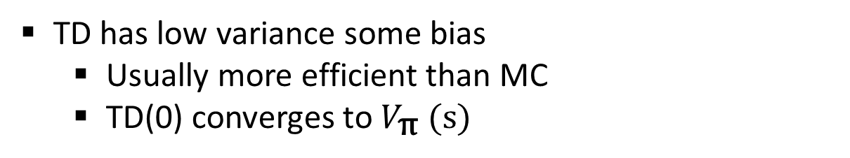
Advantages vs Disadvantages of MC vs TD (2)
INTRODUCTION TO COMPUTING
Course Code: CCINCOM/L
Monte-Carlo has high variance, zero bias
Very simple to understand and use
TD has low variance some bias
Usually more efficient than MC
TD(0) converges to $V_{\text{π}}$ (s)
Joseph Marvin R. Imperial
REINFORCEMENT LEARNING
NU College of Computing and Information Technologies
Course Code: CCRNFLRL

Slide 17
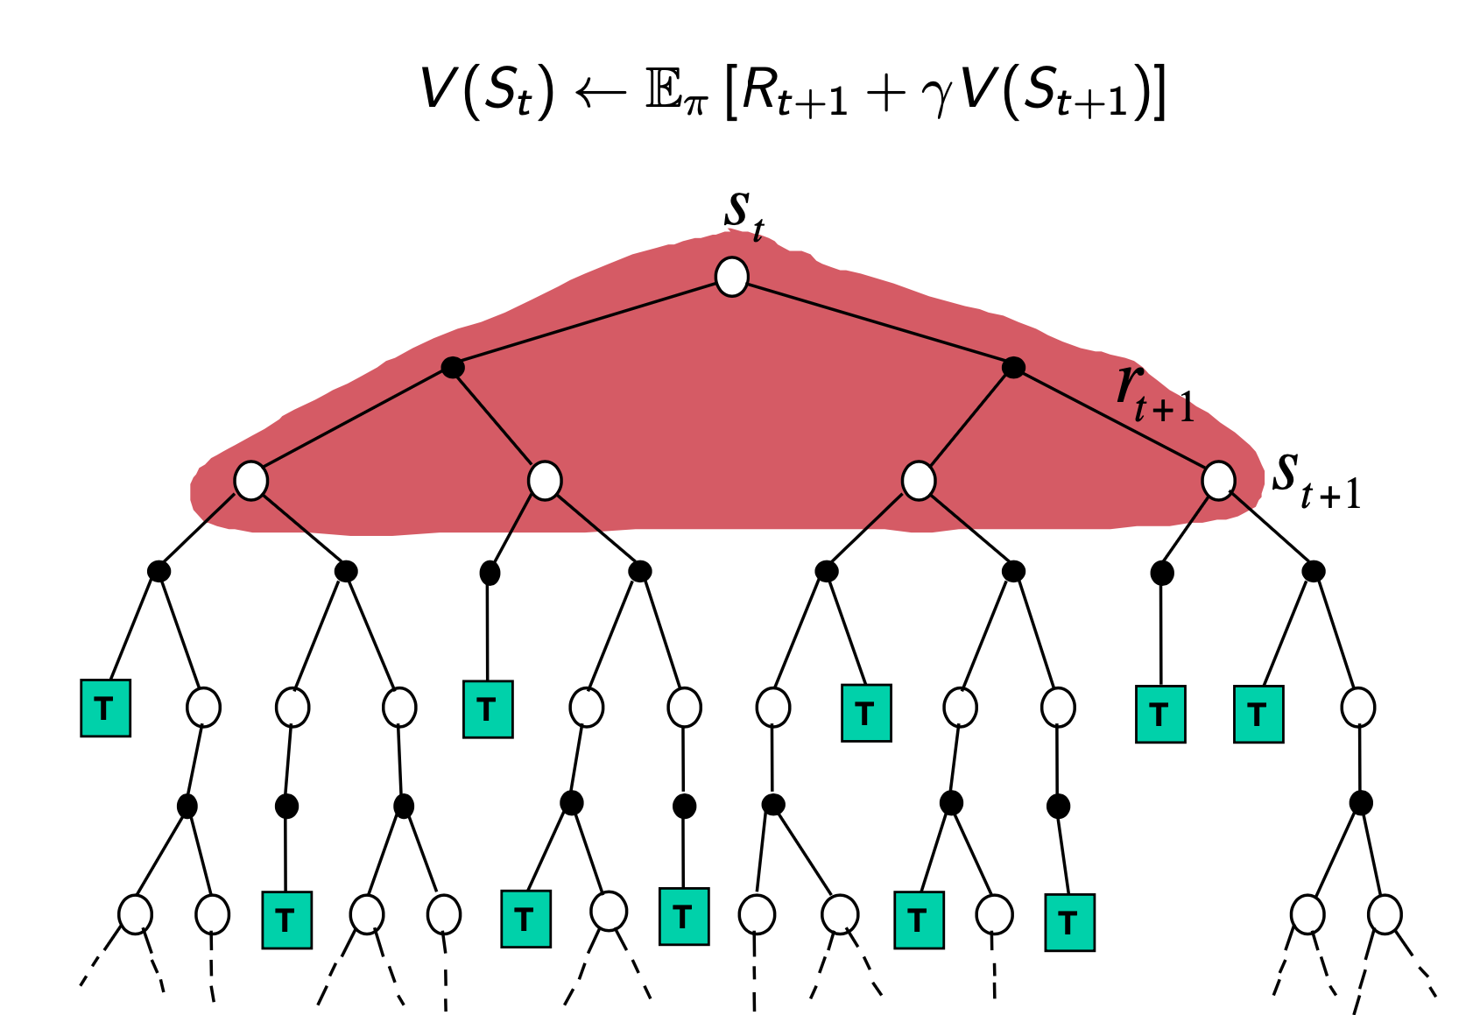
Dynamic Programming
INTRODUCTION TO COMPUTING
Course Code: CCINCOM/L
Joseph Marvin R. Imperial
REINFORCEMENT LEARNING
NU College of Computing and Information Technologies
Course Code: CCRNFLRL

Slide 18
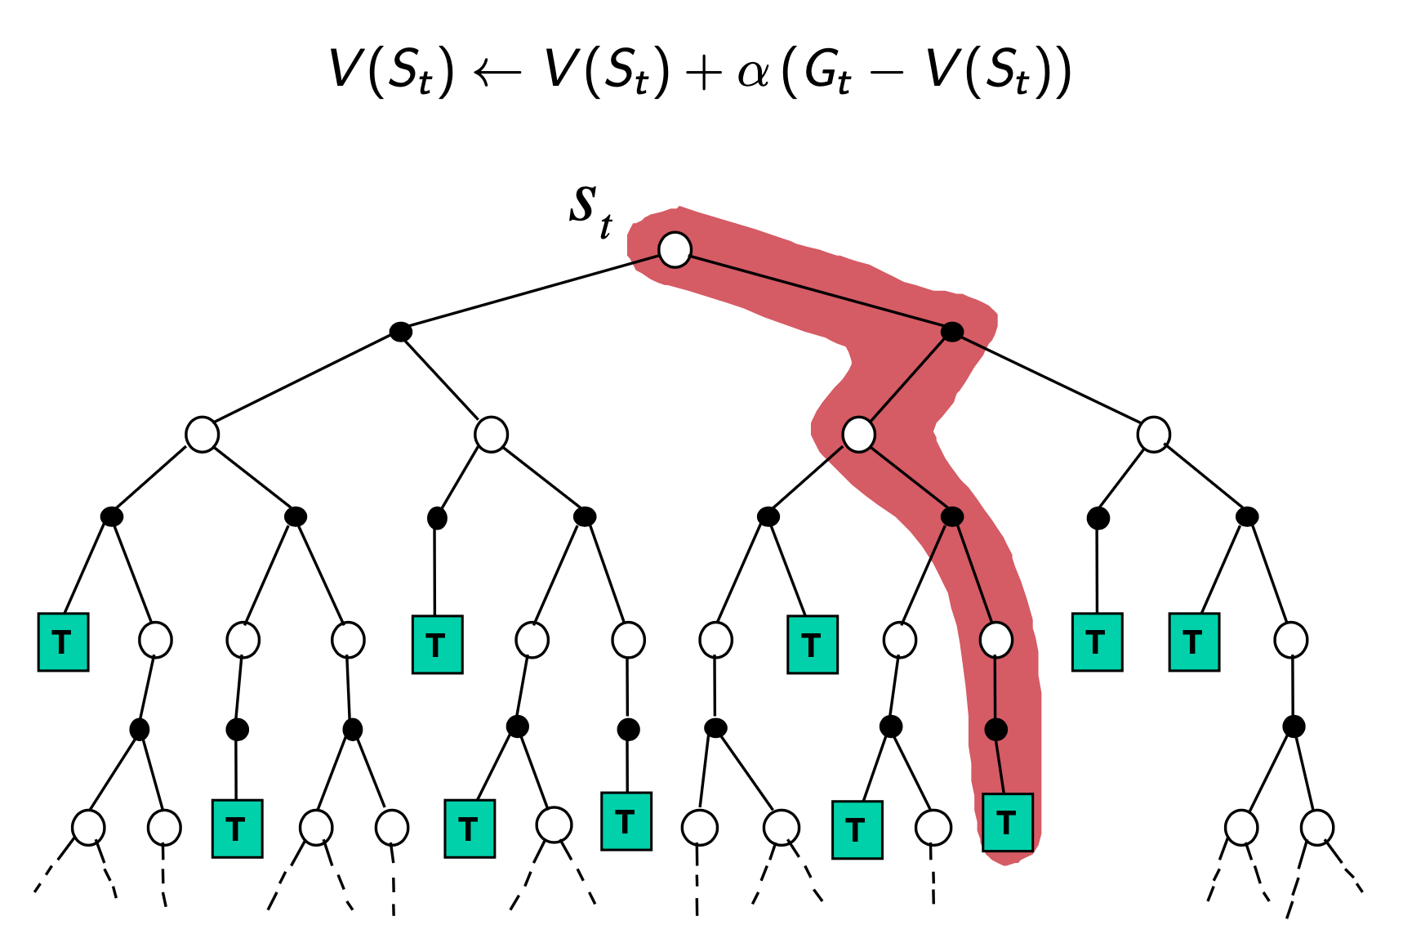
Monte-Carlo Backup
INTRODUCTION TO COMPUTING
Course Code: CCINCOM/L
Joseph Marvin R. Imperial
REINFORCEMENT LEARNING
NU College of Computing and Information Technologies
Course Code: CCRNFLRL

Slide 19
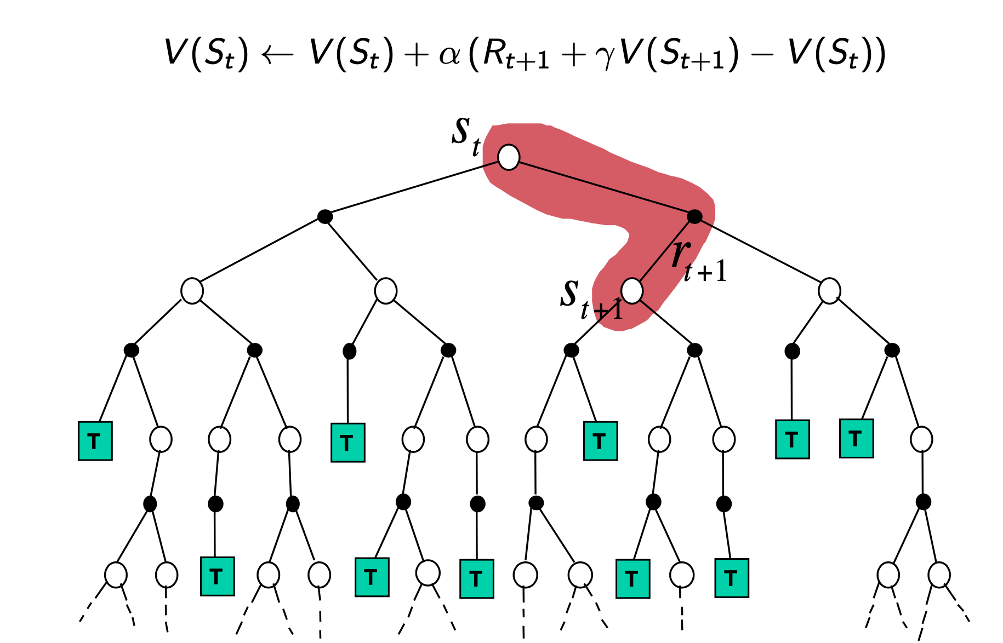
Temporal Difference Backup
INTRODUCTION TO COMPUTING
Course Code: CCINCOM/L
Joseph Marvin R. Imperial
REINFORCEMENT LEARNING
NU College of Computing and Information Technologies
Course Code: CCRNFLRL

Slide 20
Bootstrapping and Sampling
INTRODUCTION TO COMPUTING
Course Code: CCINCOM/L
Bootstrapping: updates involves an estimate
MC does not bootstrap
DP bootstraps
TD bootstraps
Sampling: updates involves an expectation
MC samples
DP does not sample
TD samples
Joseph Marvin R. Imperial
REINFORCEMENT LEARNING
NU College of Computing and Information Technologies
Course Code: CCRNFLRL

Slide 21
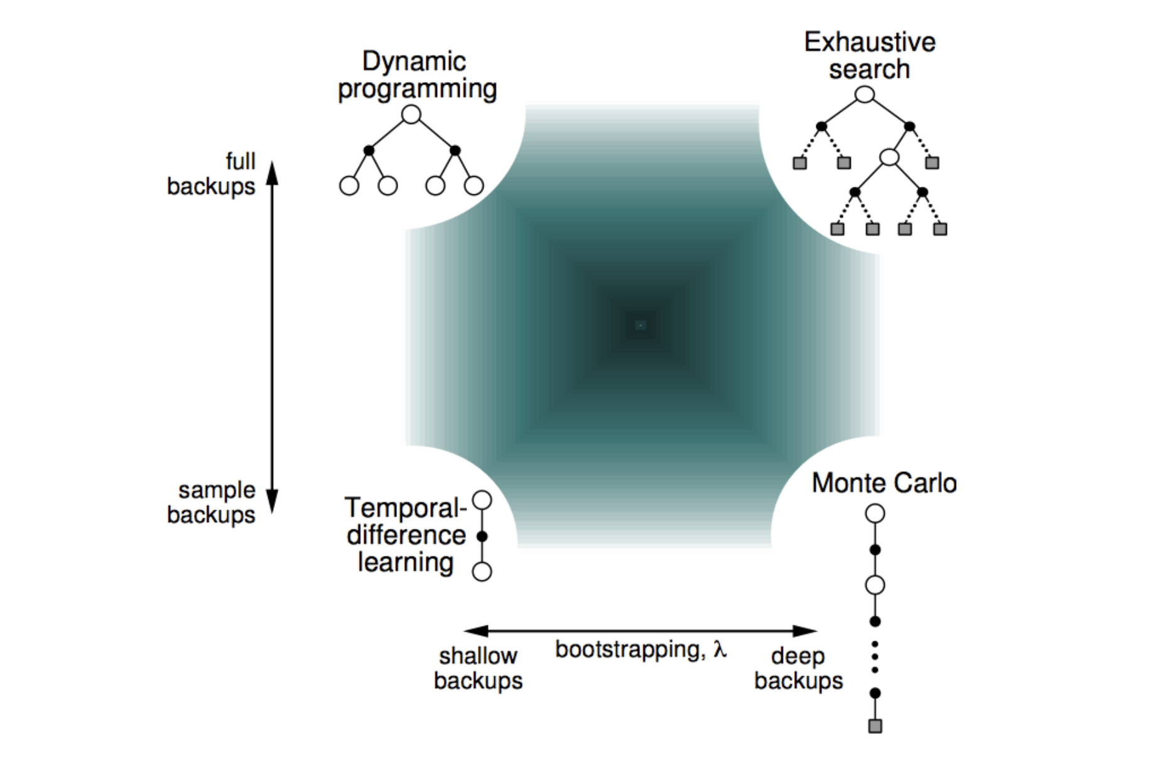
Unified view of Reinforcement Learning
INTRODUCTION TO COMPUTING
Course Code: CCINCOM/L
Joseph Marvin R. Imperial
REINFORCEMENT LEARNING
NU College of Computing and Information Technologies
Course Code: CCRNFLRL

Slide 22
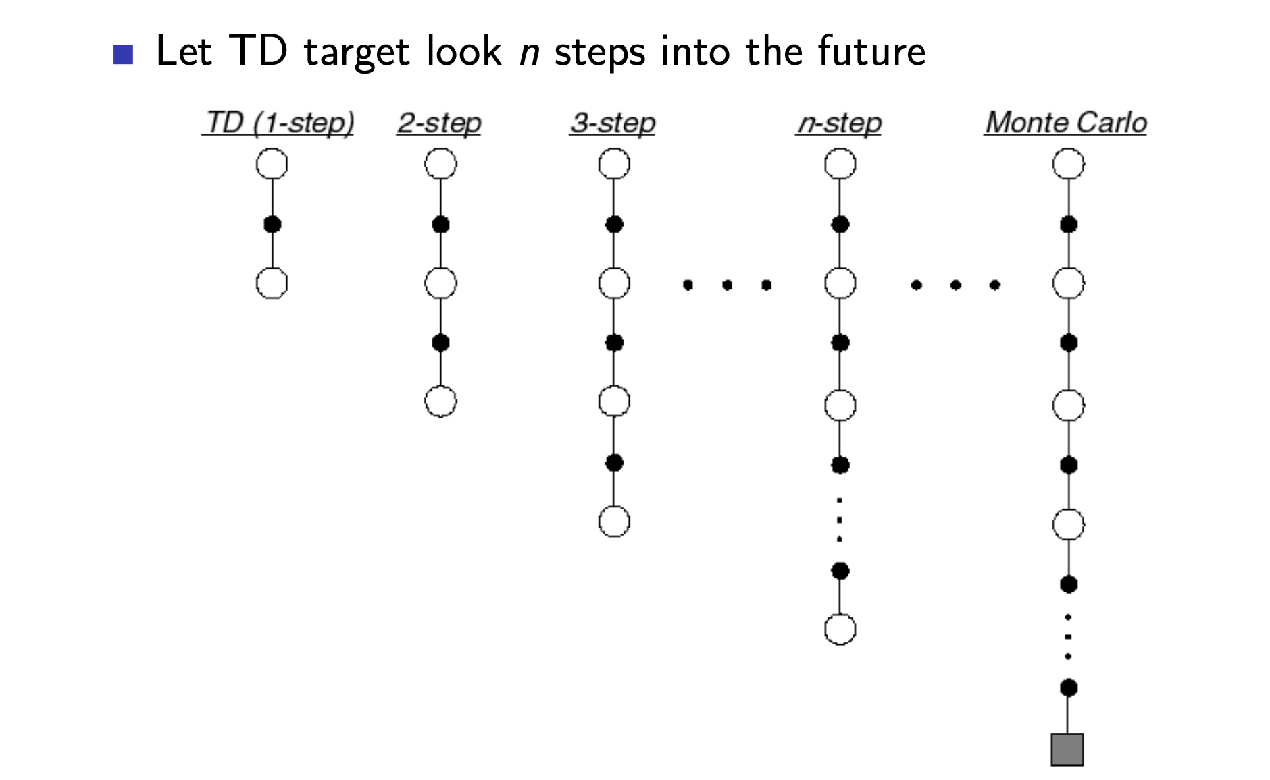
TD (λ)
INTRODUCTION TO COMPUTING
Course Code: CCINCOM/L
Joseph Marvin R. Imperial
REINFORCEMENT LEARNING
NU College of Computing and Information Technologies
Course Code: CCRNFLRL

Slide 23
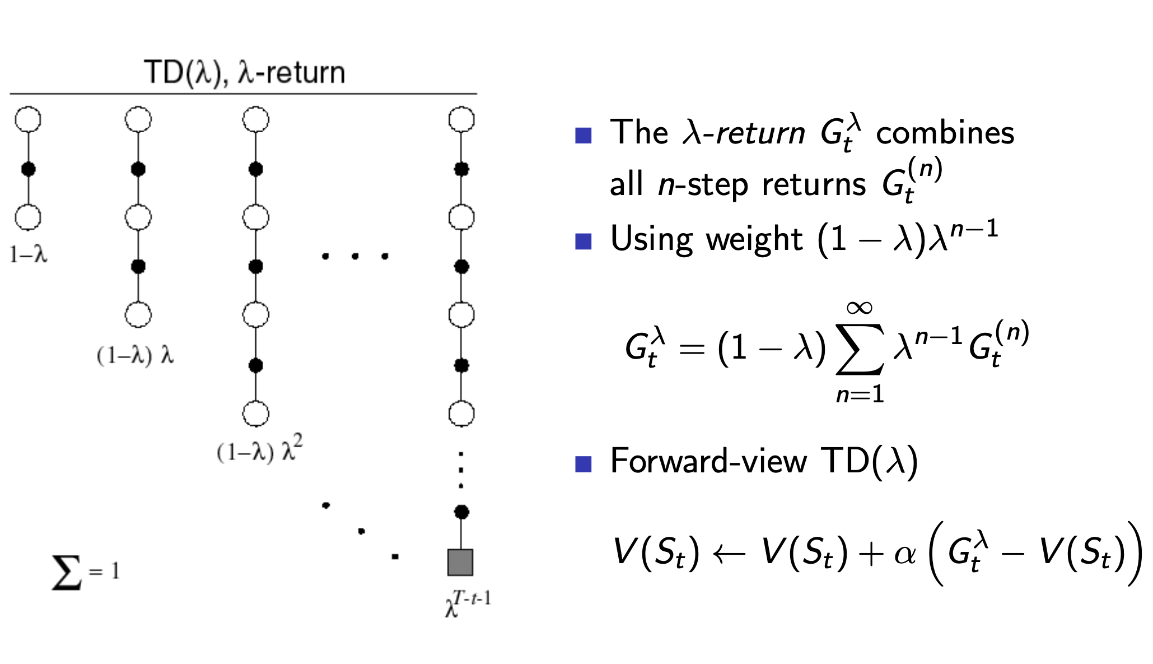
TD (λ)
INTRODUCTION TO COMPUTING
Course Code: CCINCOM/L
Joseph Marvin R. Imperial
REINFORCEMENT LEARNING
NU College of Computing and Information Technologies
Course Code: CCRNFLRL

Slide 24
References
INTRODUCTION TO COMPUTING
Course Code: CCINCOM/L
Images are licensed with Creative Commons. Can use without citing.
Prof. Emma Brunskill’s slides (CS234RL). https://web.stanford.edu/class/cs234/slides/lecture1.pdf
David Silver’s slides. https://www.davidsilver.uk/wp-content/uploads/2020/03/intro_RL.pdf
Review in Probability, Intro to RL Concepts
Joseph Marvin R. Imperial
REINFORCEMENT LEARNING
NU College of Computing and Information Technologies
Course Code: CCRNFLRL

